Slide 1

Turning Biology Into precision biology
Cédric Notredame
Comparative Bioinformatics
Bioinformatics and Genomics Program

Slide 2
“The Ultimate Fate of Biological data is to be (multiply) Compared” Source: Heard in a Pub in Cambridge, Late…

Slide 3
What Can We Compare Today ?
Gene Sequences : RNA, Proteins
Structures: RNA, Proteins, Genomes
Genome Sequences: CNV, Epigenetics
Omics Phenotypes: Transcriptomes, Proteomes, Metabolomes,
Phenotypes and Behaviors: Big Data

Slide 4
What Does Precision Biology Need?
Ultra powered Data
Biology
Efficient and accurate Algorithms
Comp. Science
Reproducibility
IT
The Right Statistics
Mathematics

Slide 5
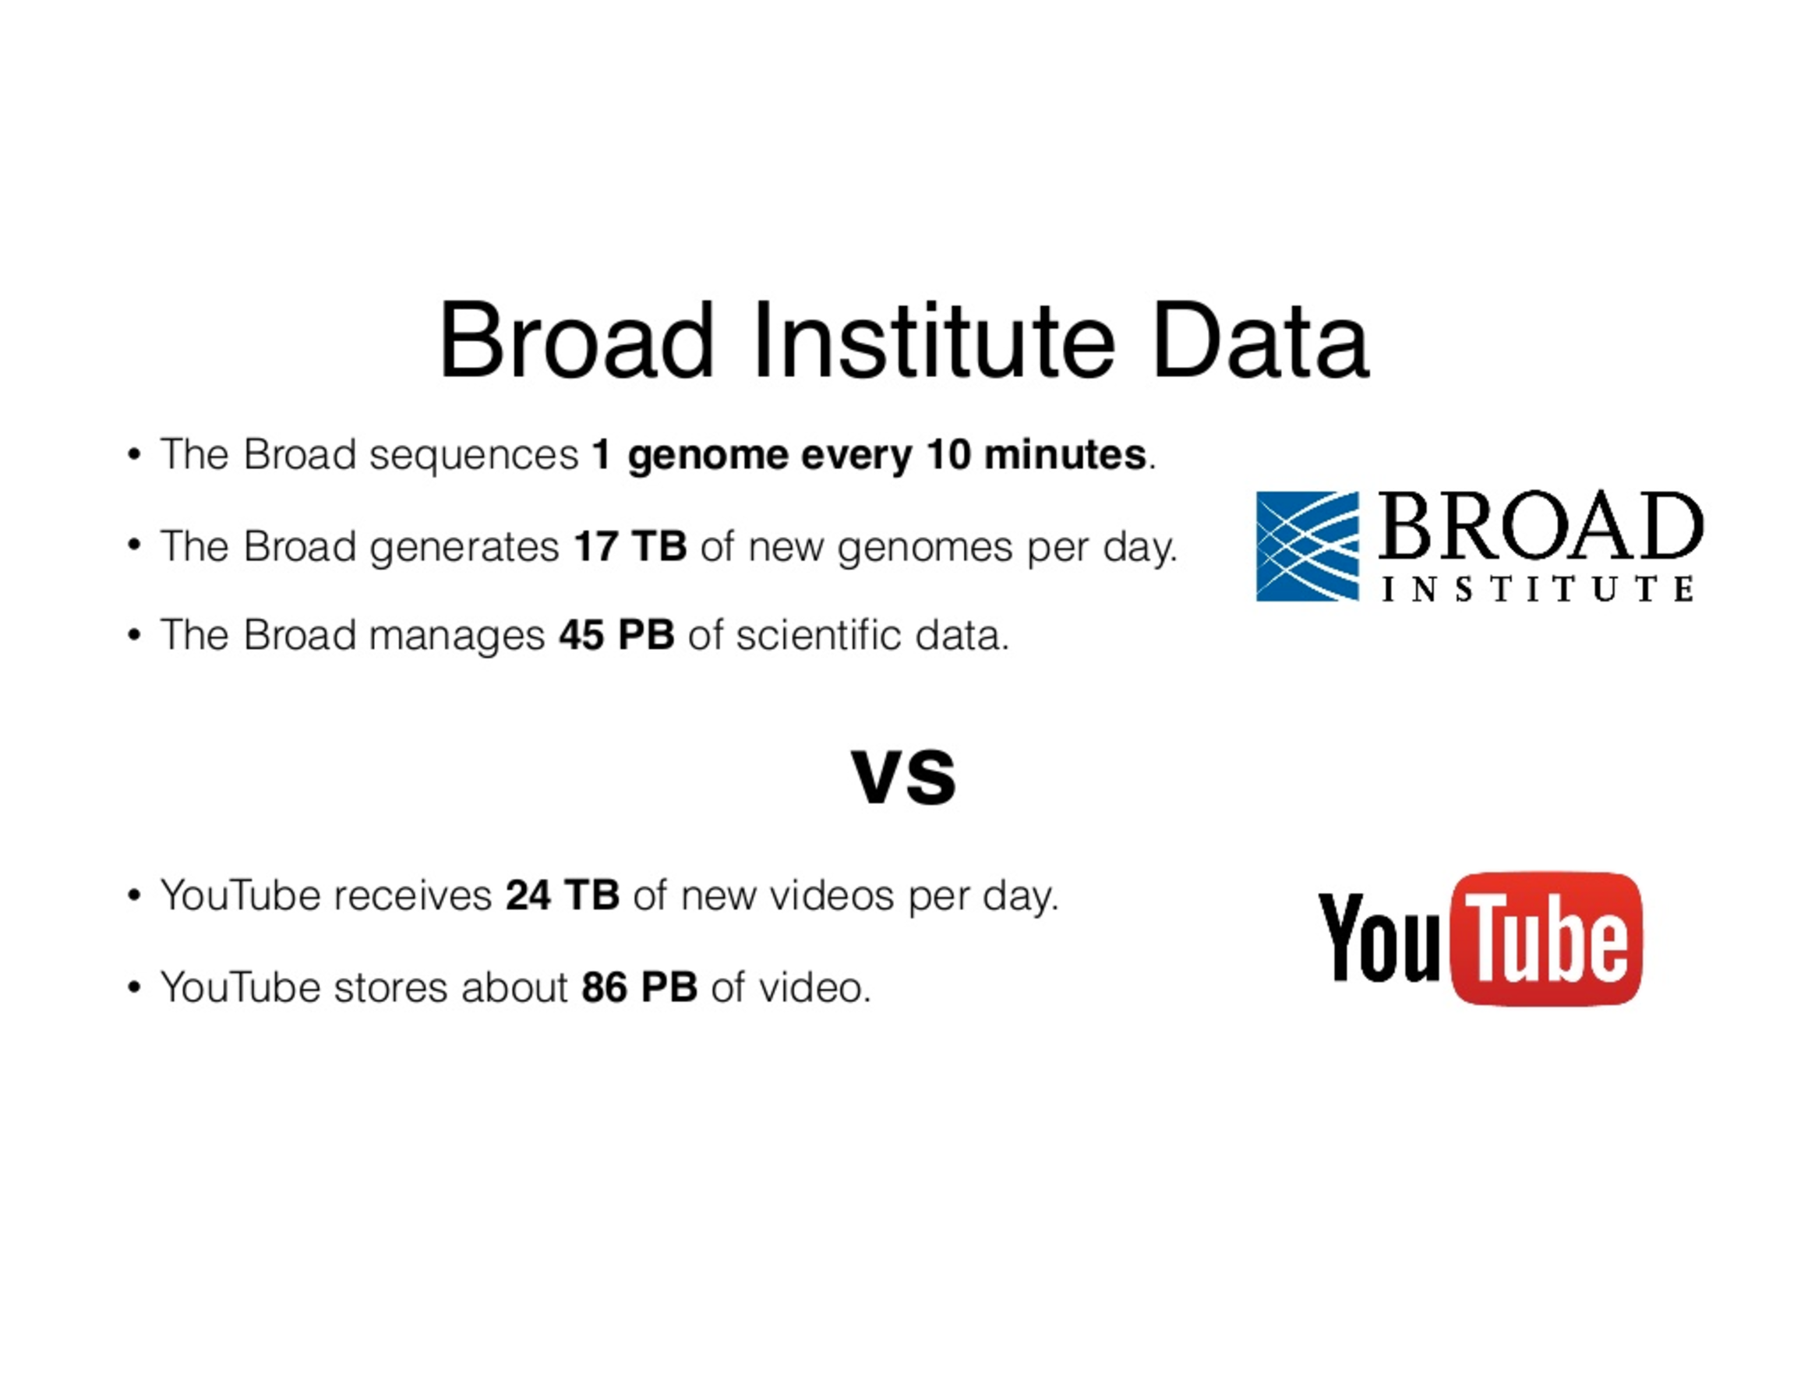
* courtesy of Broad Institute

Slide 6
Reproducible Computation

Slide 7
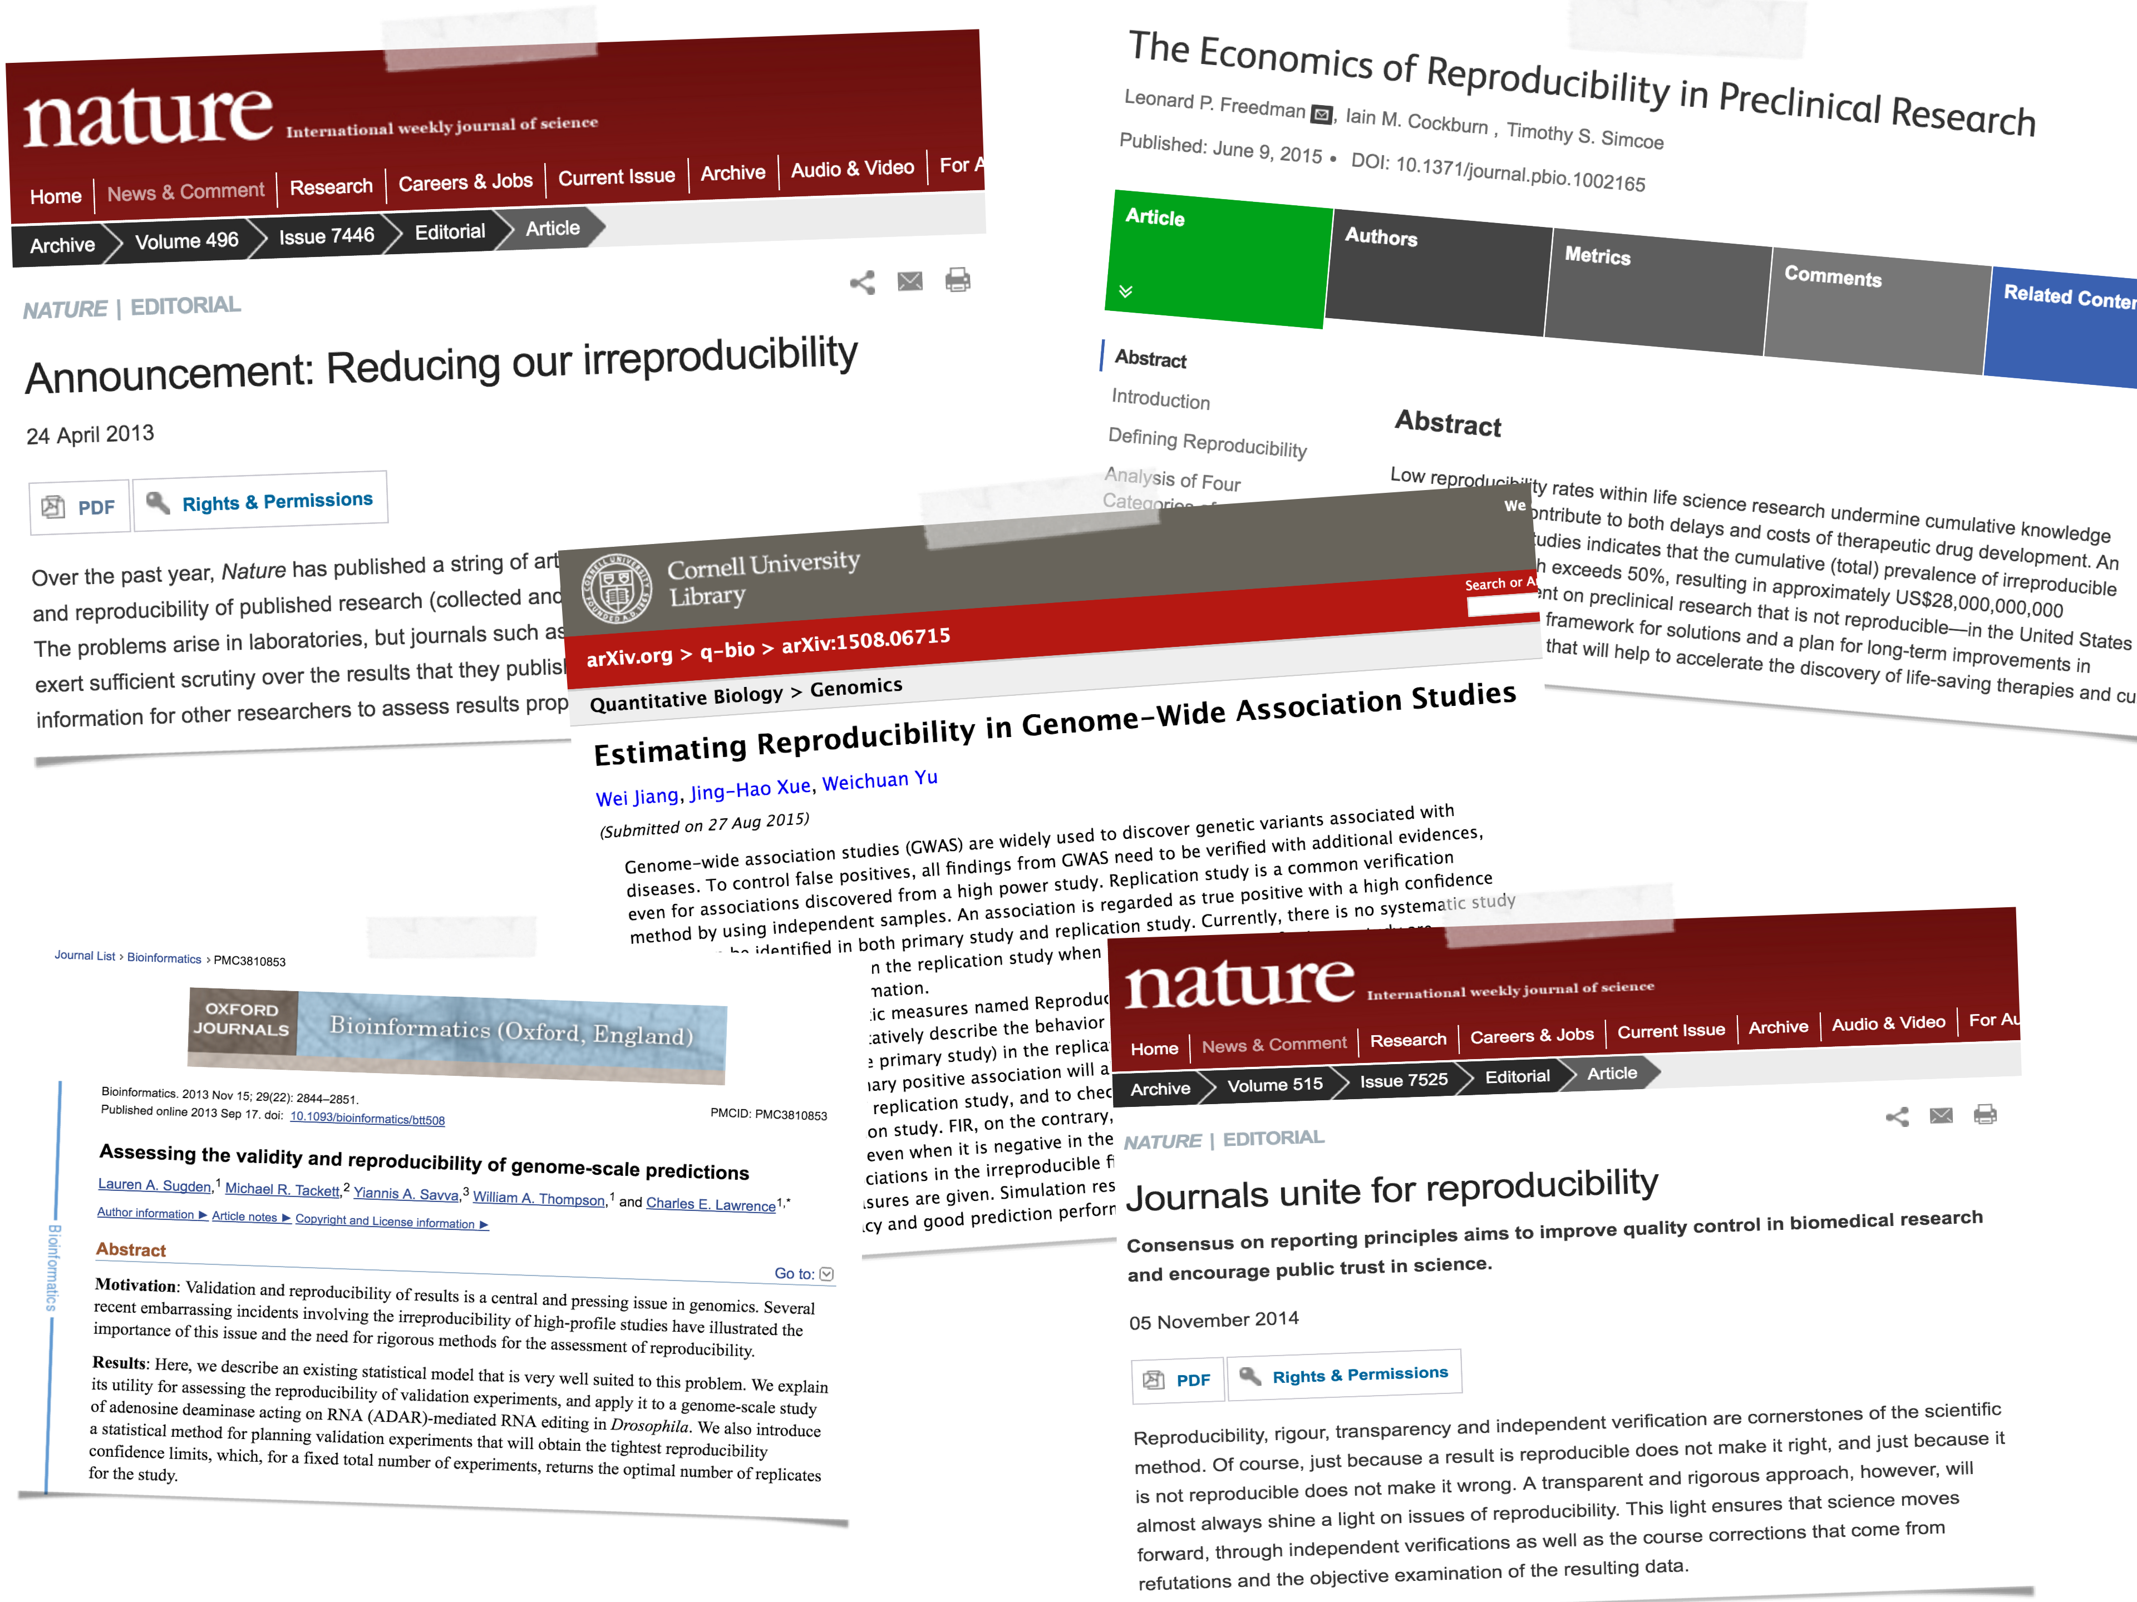

Slide 8
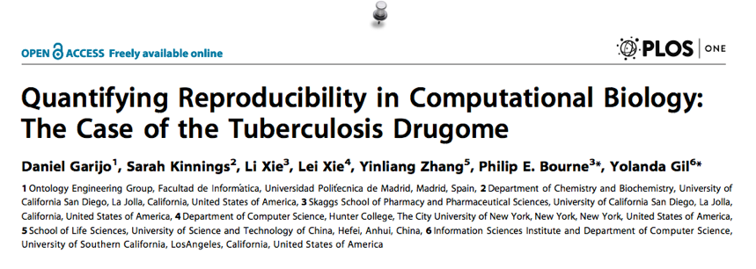
To replicate the result of a typical computational biology paper requires 280 hours!
Notes:
And not only is Computational Research hard to reproduce, it is also very time consuming… It seems that if someone wants to replicate the results of a typical biological paper it requires 280 hours!
So it somehow feels like bioinformaticians are now required to spend 8 hours doing research, 8 hours coding and the remaining hours of their day, instead of sleeping trying to reproduce the results of others!!!

Slide 9
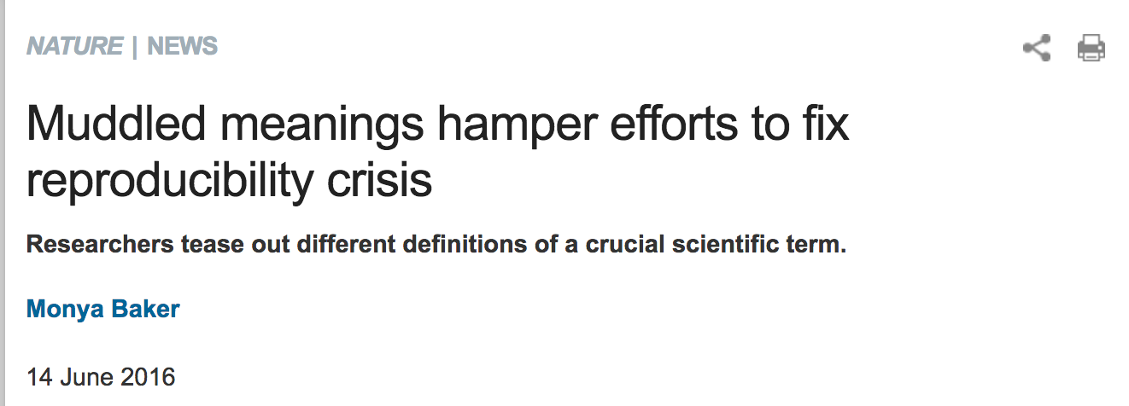
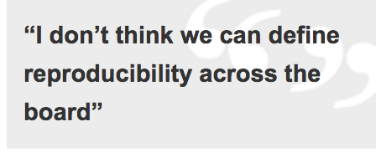
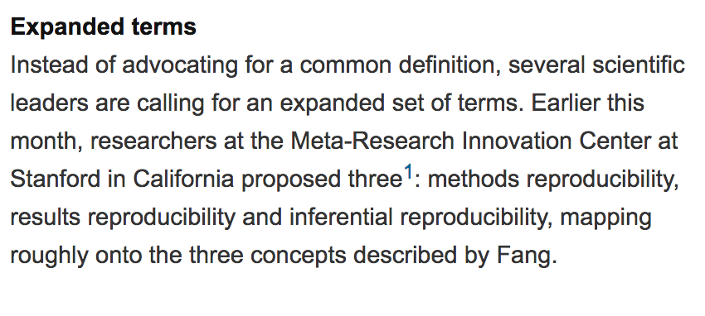

Slide 10
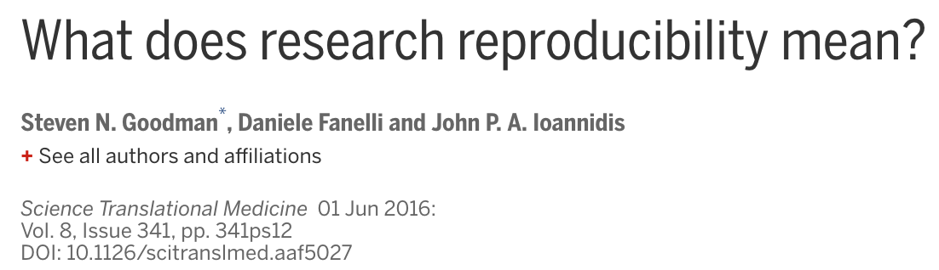
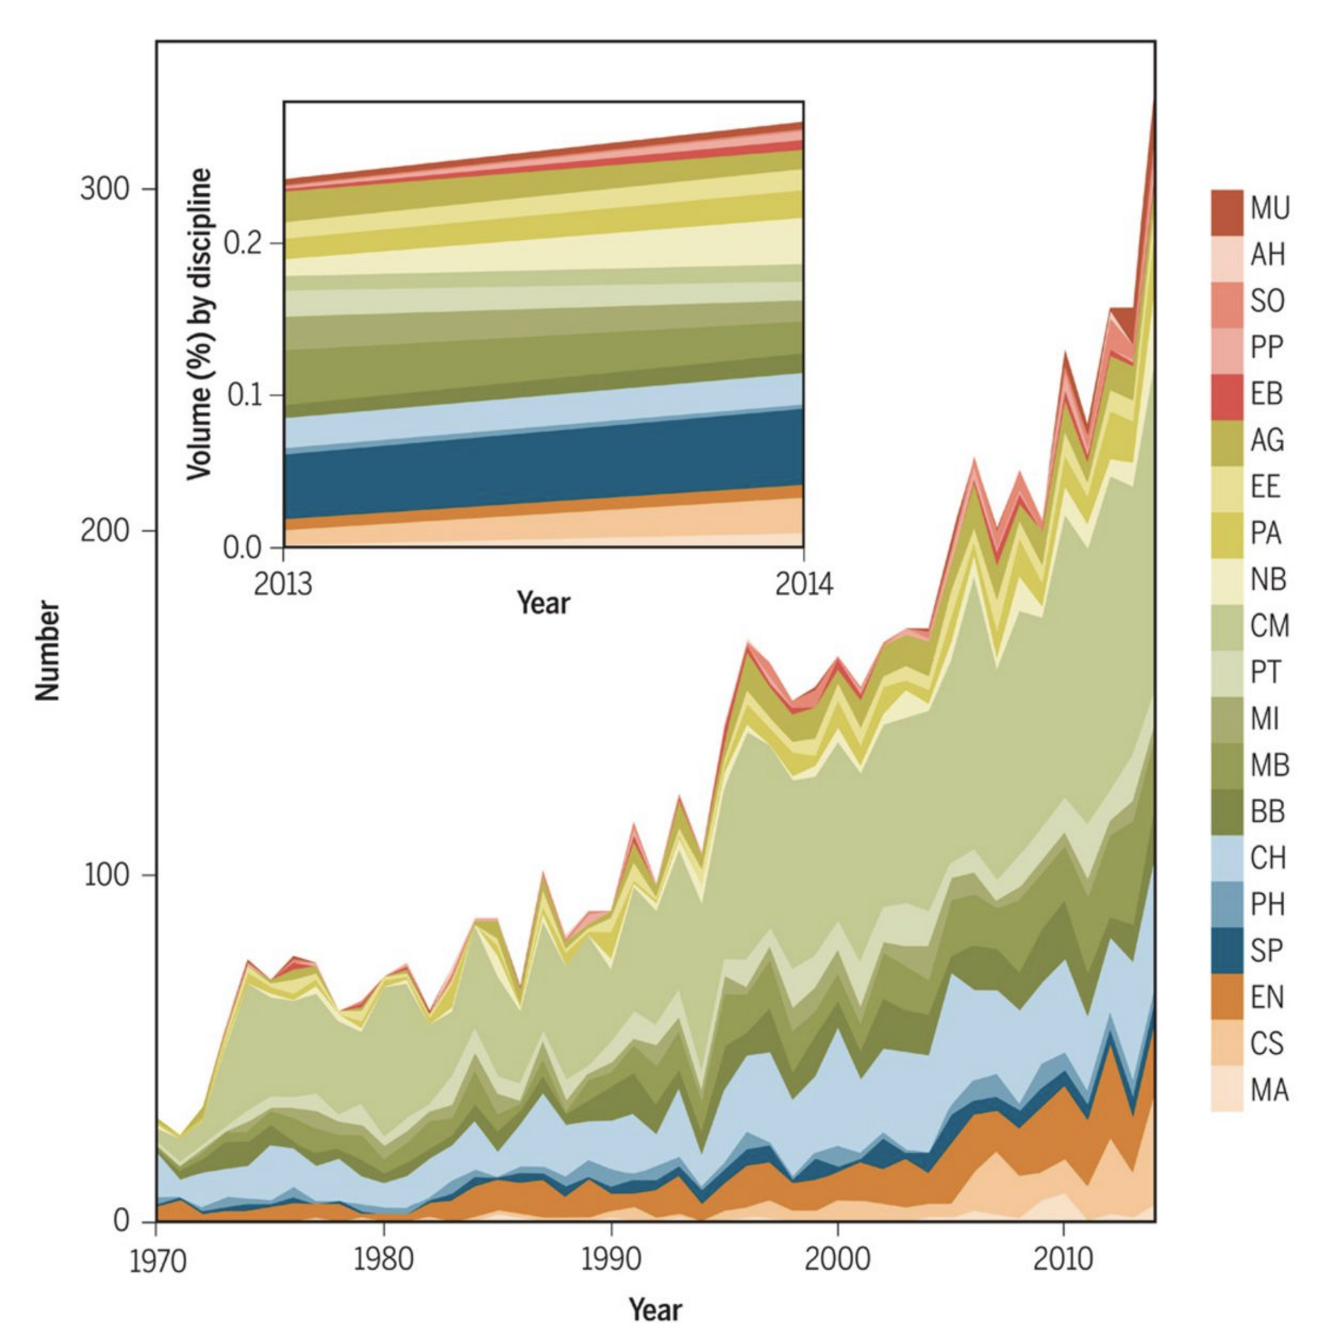
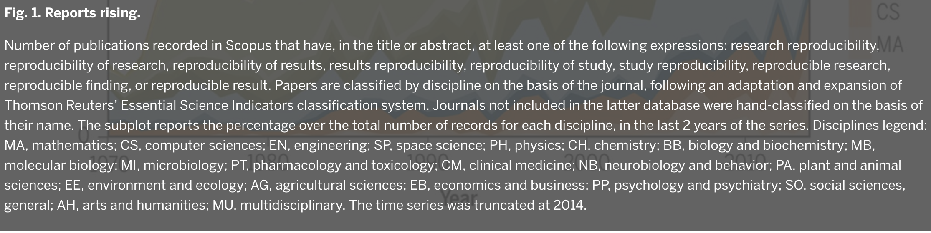

Slide 11

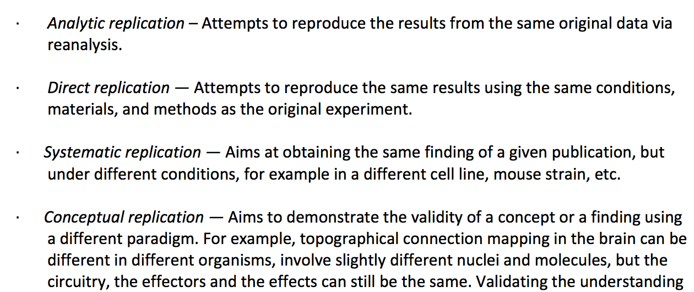

Slide 12
What Shall We do ?

Slide 13
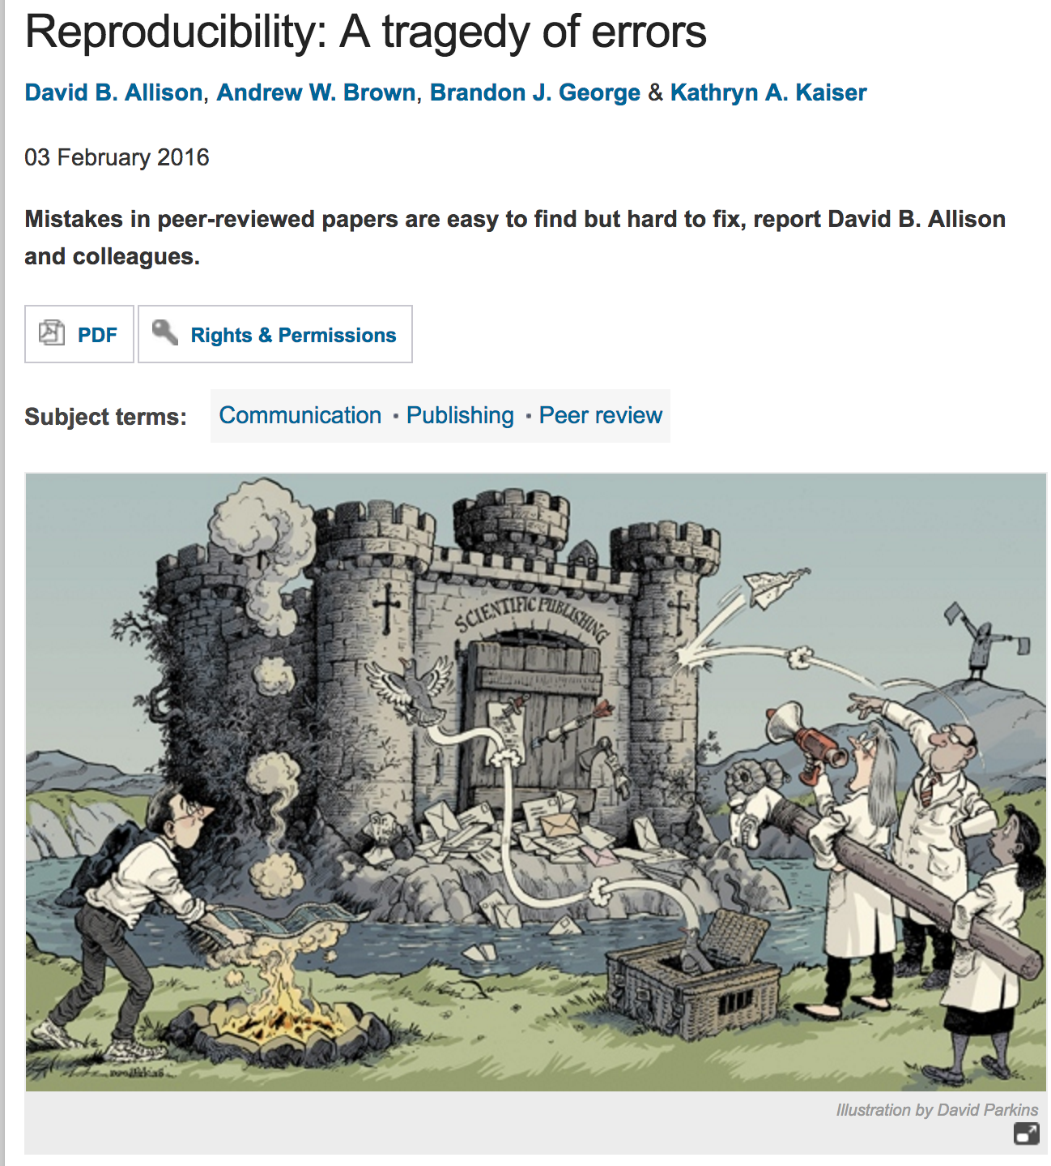
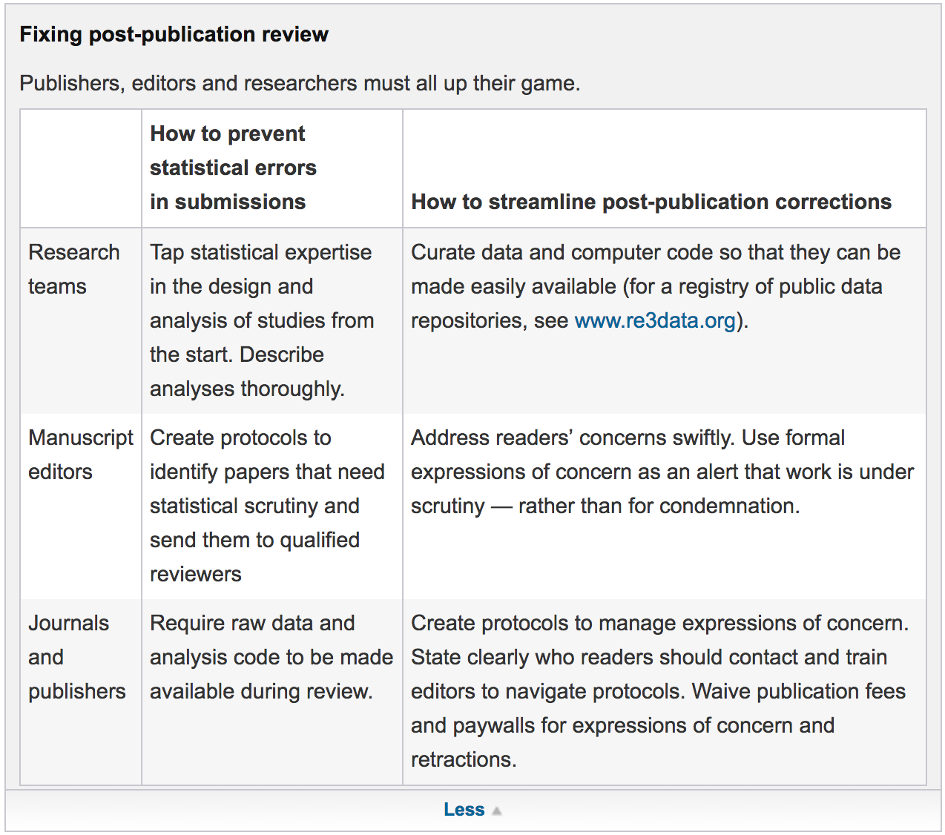

Slide 14
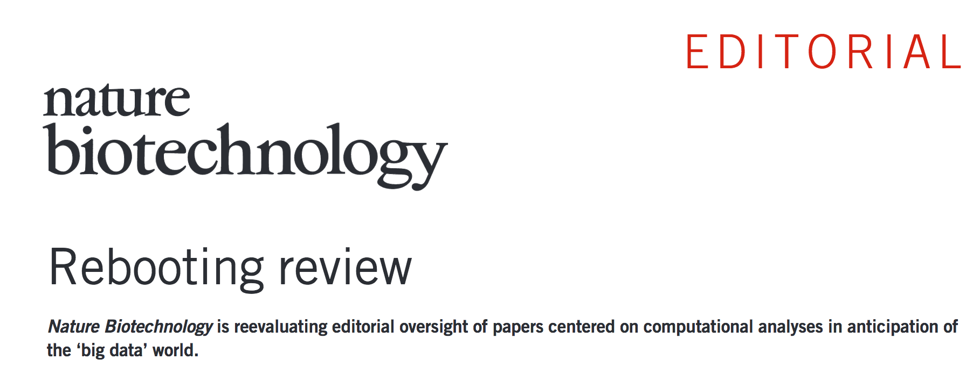

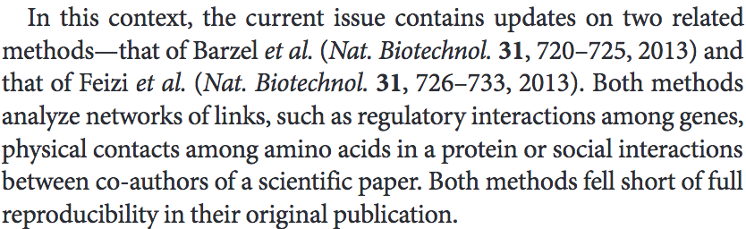

Slide 15
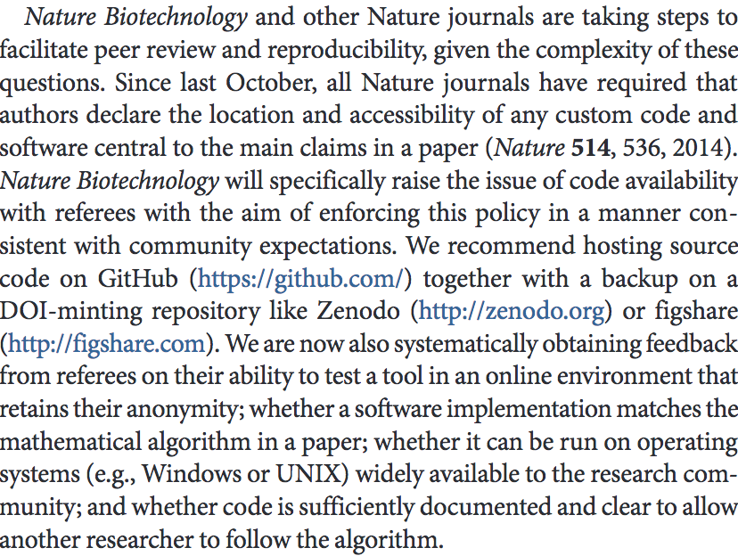

Slide 16
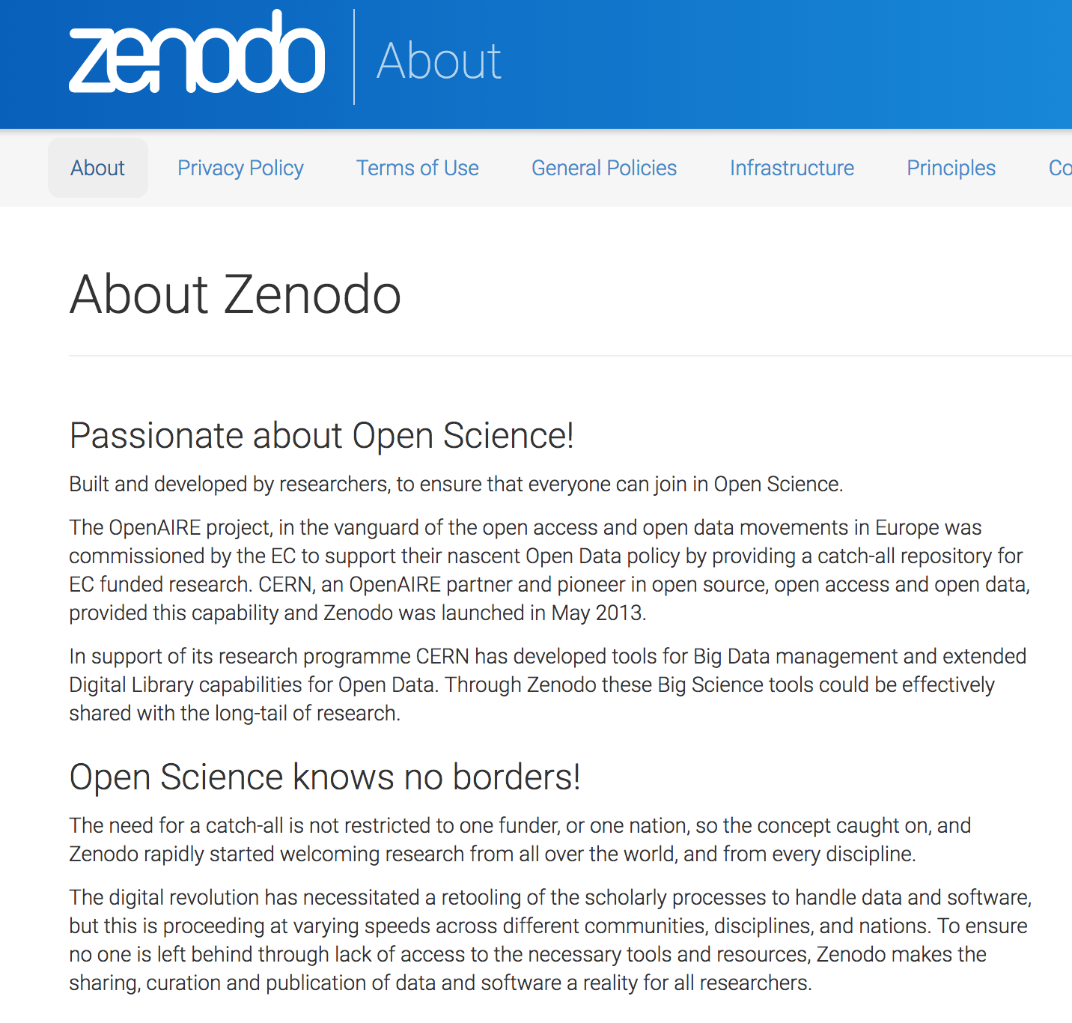
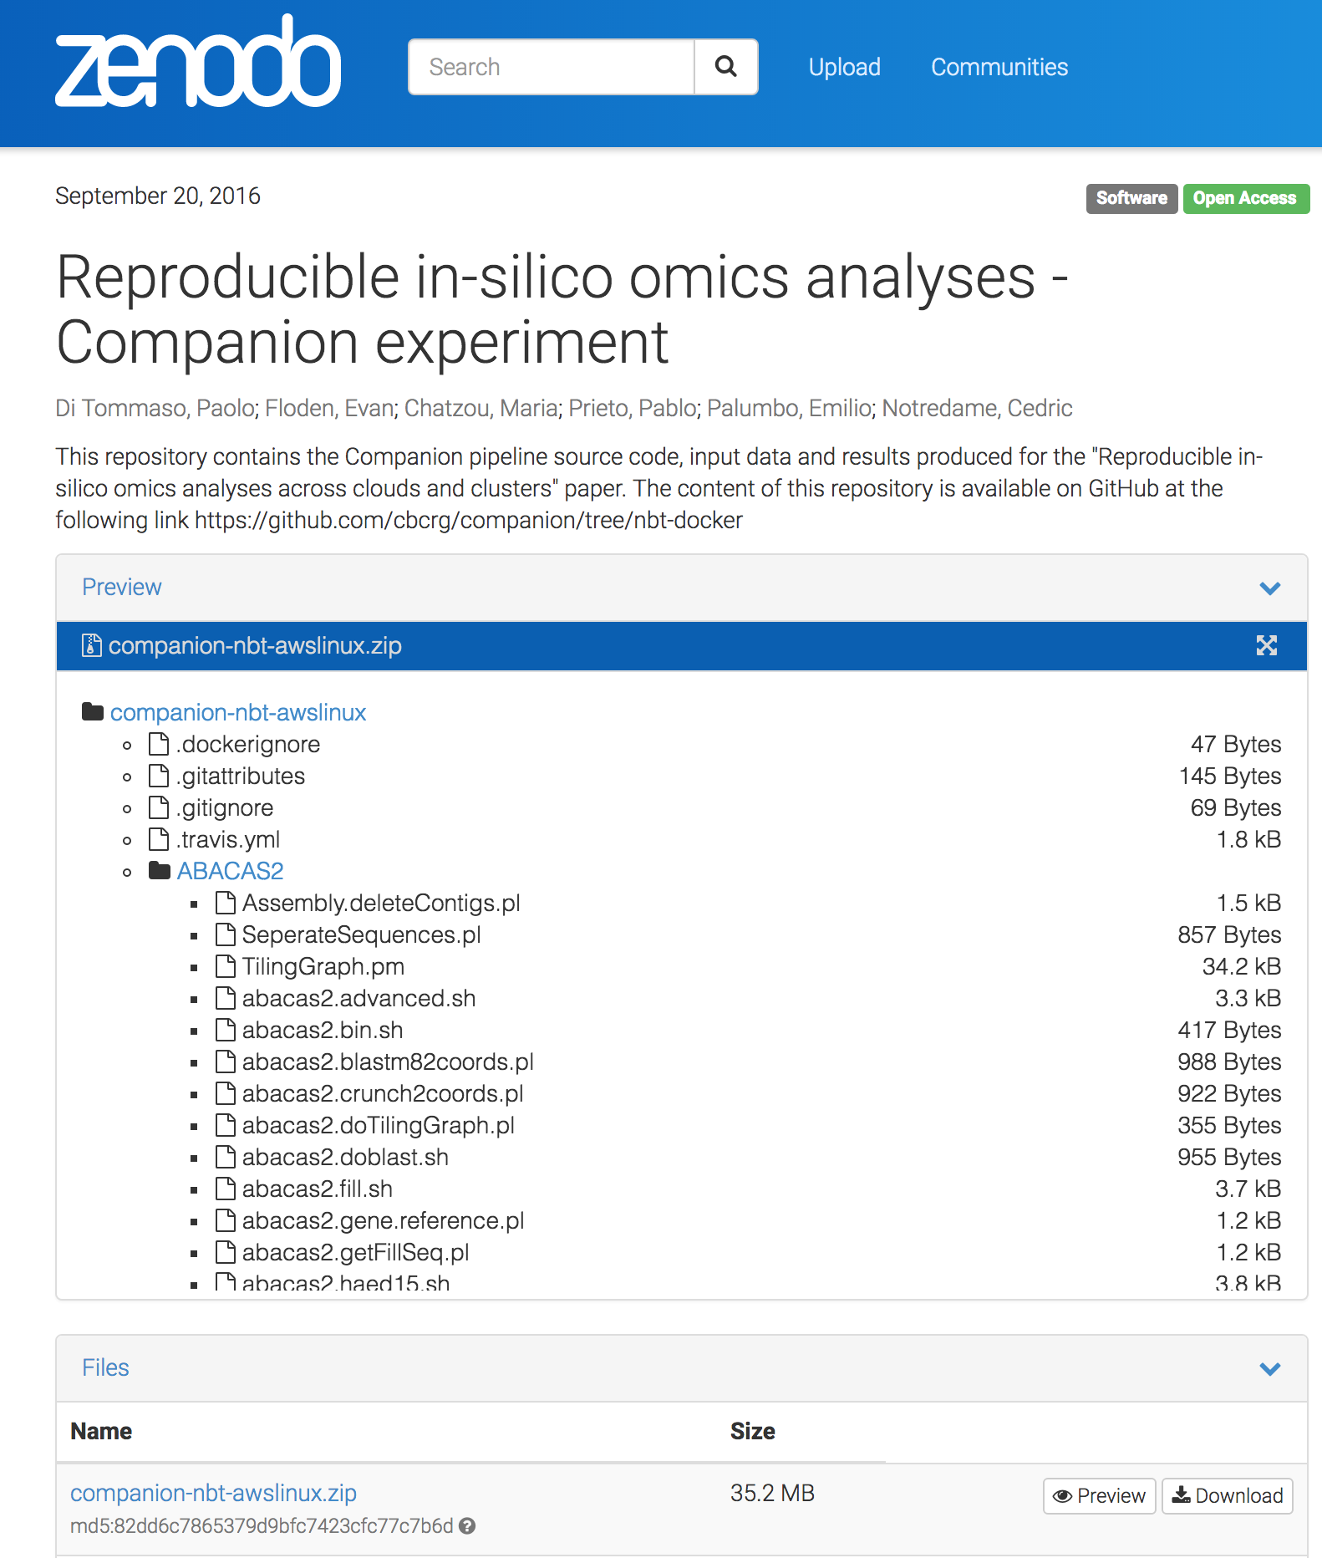

Slide 17
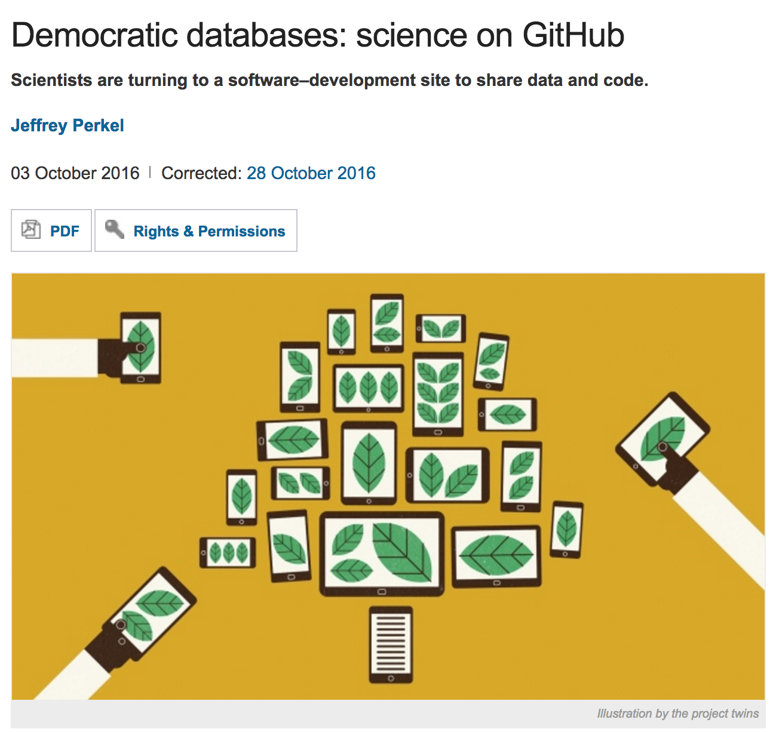
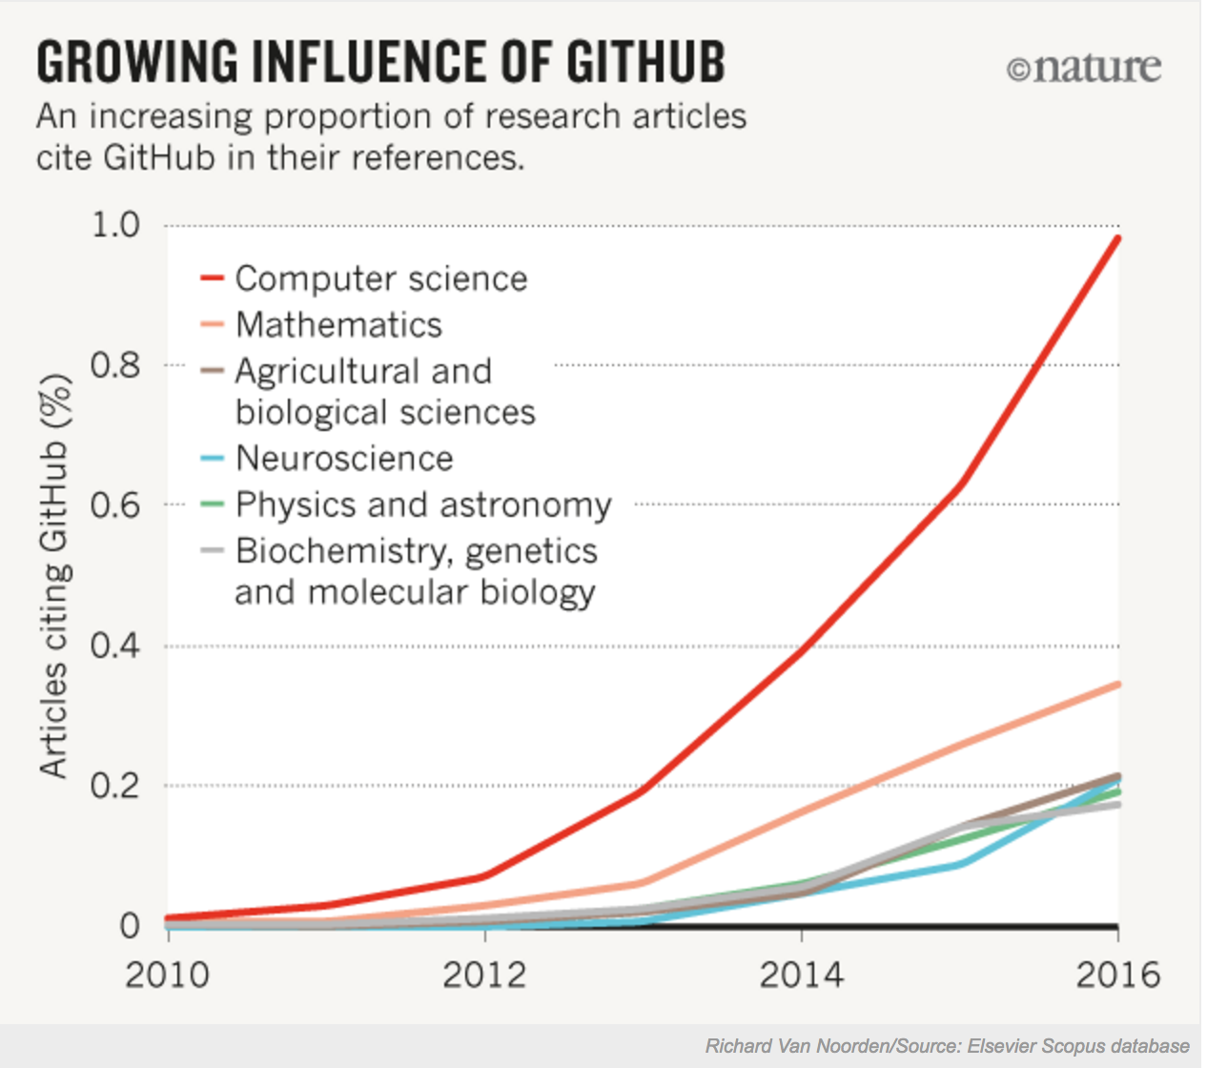

Slide 18
What We did?

Slide 19
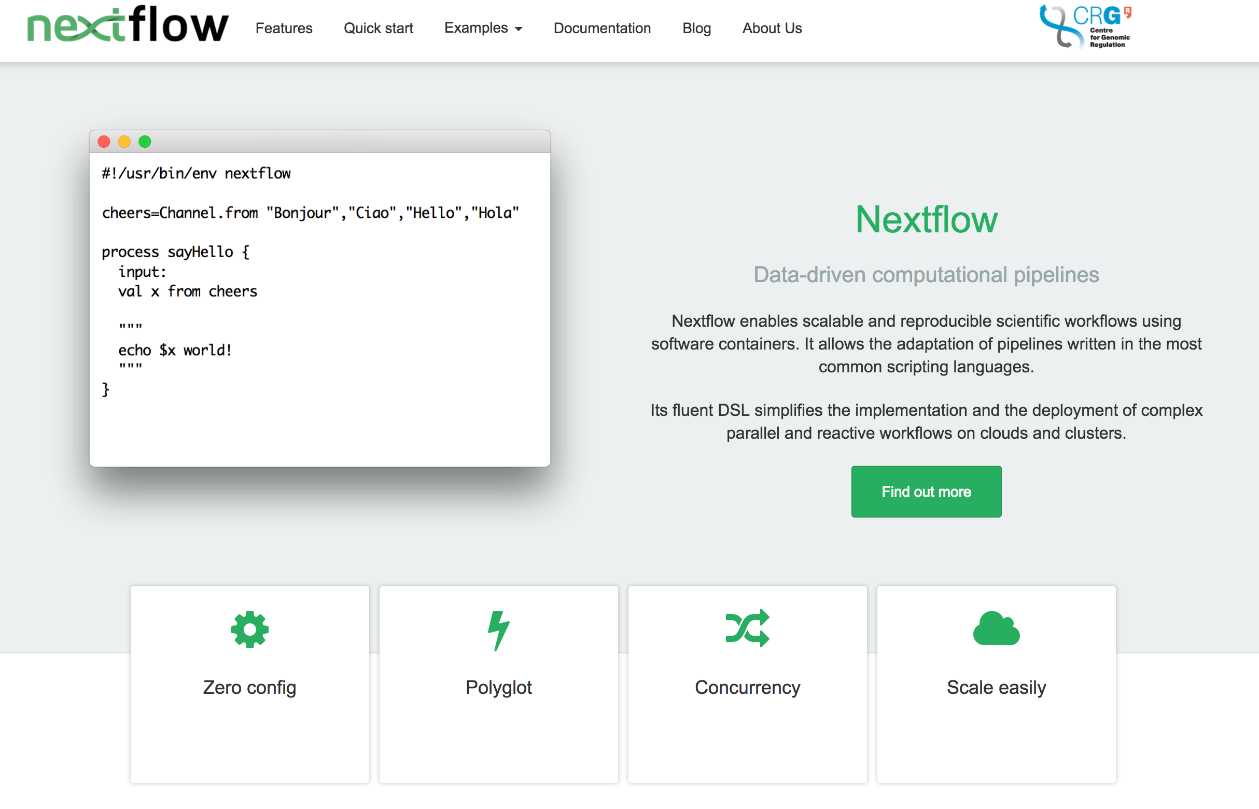
www.nextflow.org

Slide 20

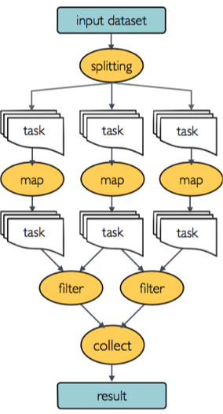


Automatic Parallelization
→ Dataflow Model, a high-level parallelization model
Polyglot
Reuse of any existing scripts/tools
Resumption of Pipelines – Continues checkpoints &
Computation Agnostic
Cashing system
Virtualization & Packaging
→ Docker integration
Portable
→ Platform agnostic
Notes:
The technology produces a prodigious stream of data that can only be processed in a timely manner by parallelizing and distributing the workload in a high performance and distributed data center.
We wished that our huge and almost cryptic BASH-based pipelines could handle parallelization automatically. In our effort to make that happen we stumbled upon the Dataflow programming model and Nextflow was created. We were getting furious every time our two-week long pipelines were crashing and we had to re-execute them from the beginning. We, therefore, developed a caching system, which allows Nextflow to resume any pipeline from the last executed step. While we were really enjoying developing a new DSL and creating our own operators, at the same time we were not willing to give up our favorite PERL/Python scripts and one-liners, and thus Nextflow became a polyglot.
Another problem we were facing was that our pipelines were invoking a lot of third-party software, making distribution and execution on different platforms a nightmare. Once again while searching for a solution to this problem, we were able to identify a breakthrough technology Docker, which is now revolutionising cloud computation Of course, sharing our pipelines with our friends rapidly became a necessity and so we had to make Nextflow smart enough to support Github and Bitbucket integration.

Slide 21
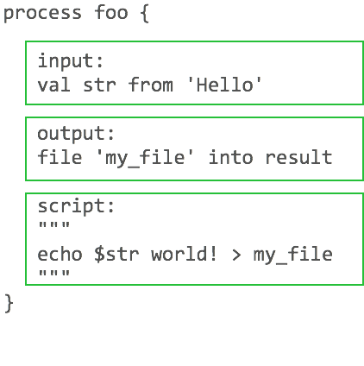
Process definition

Slide 22
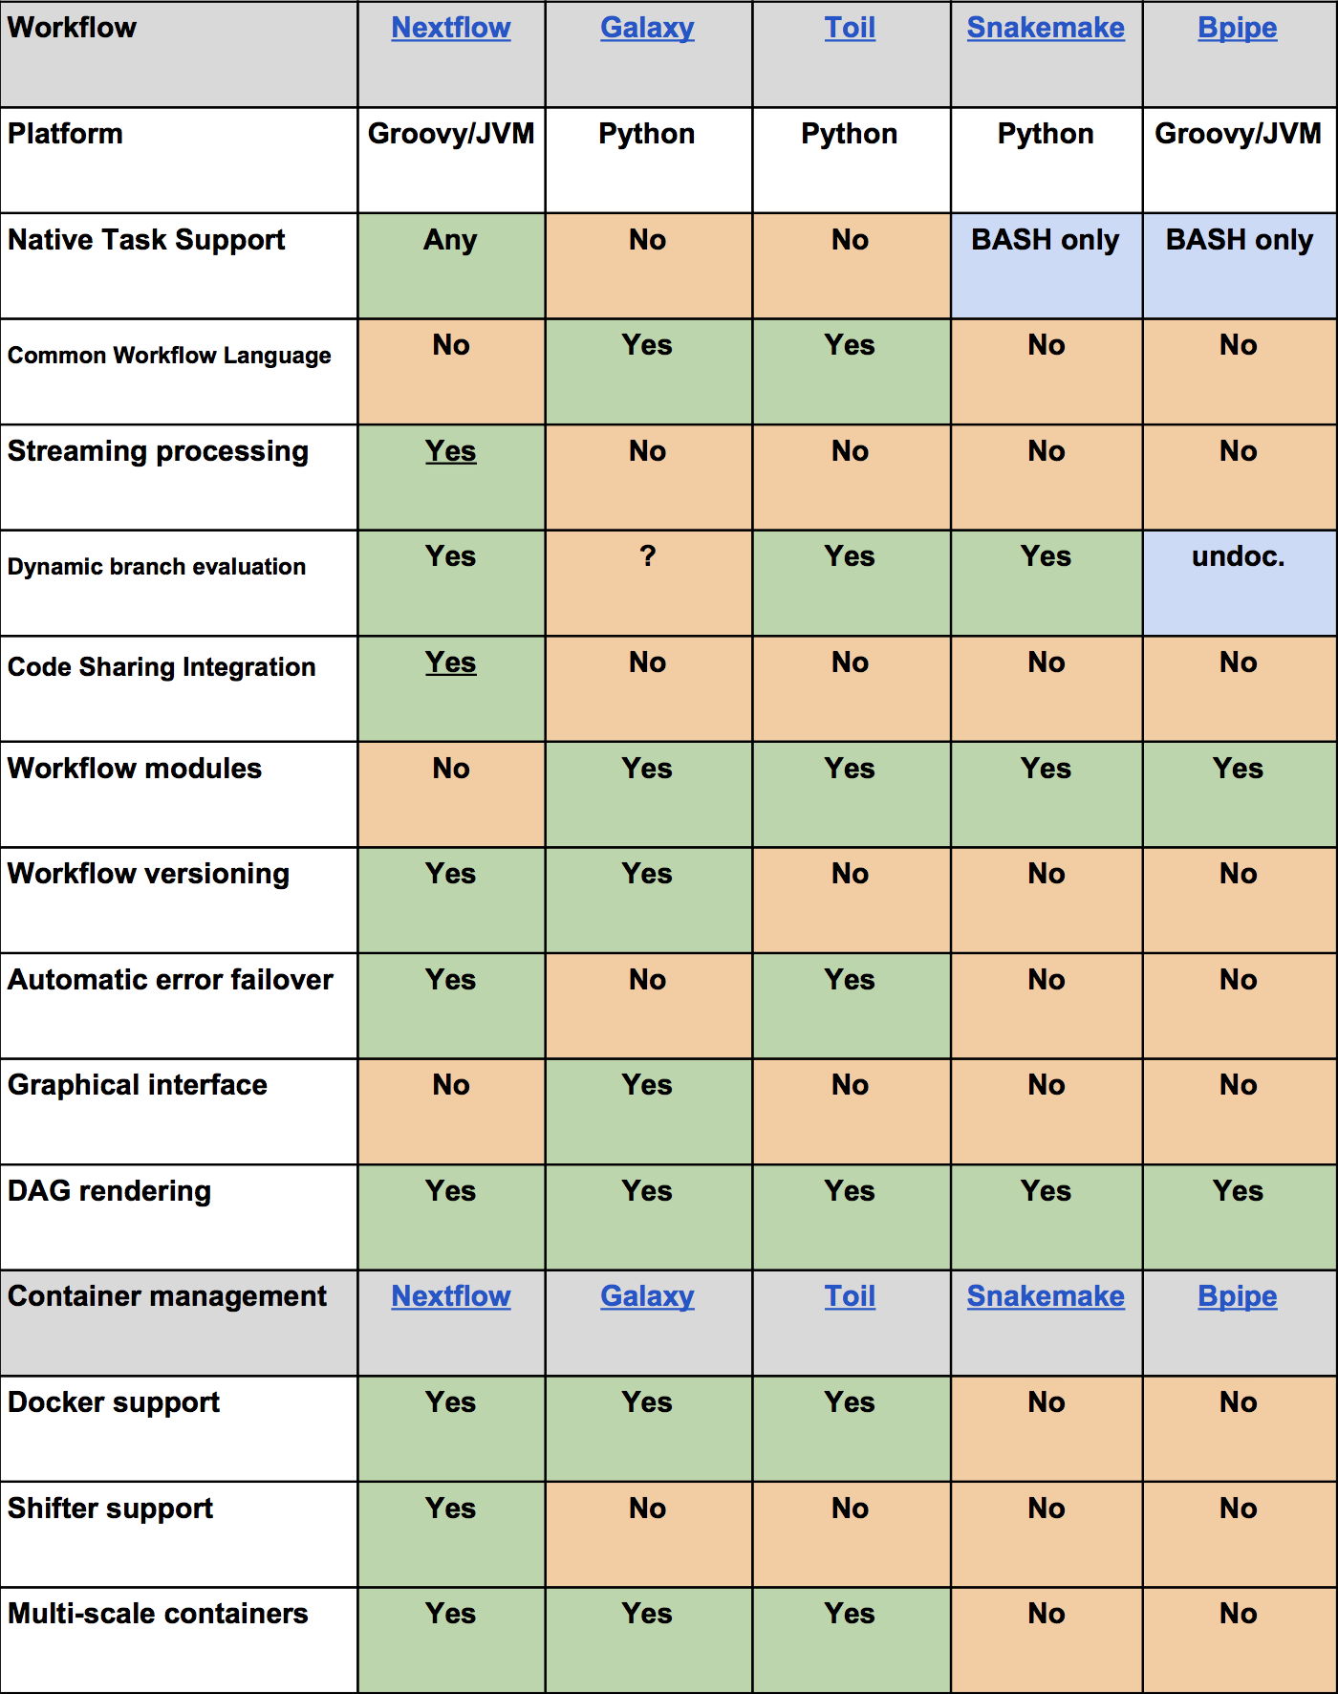
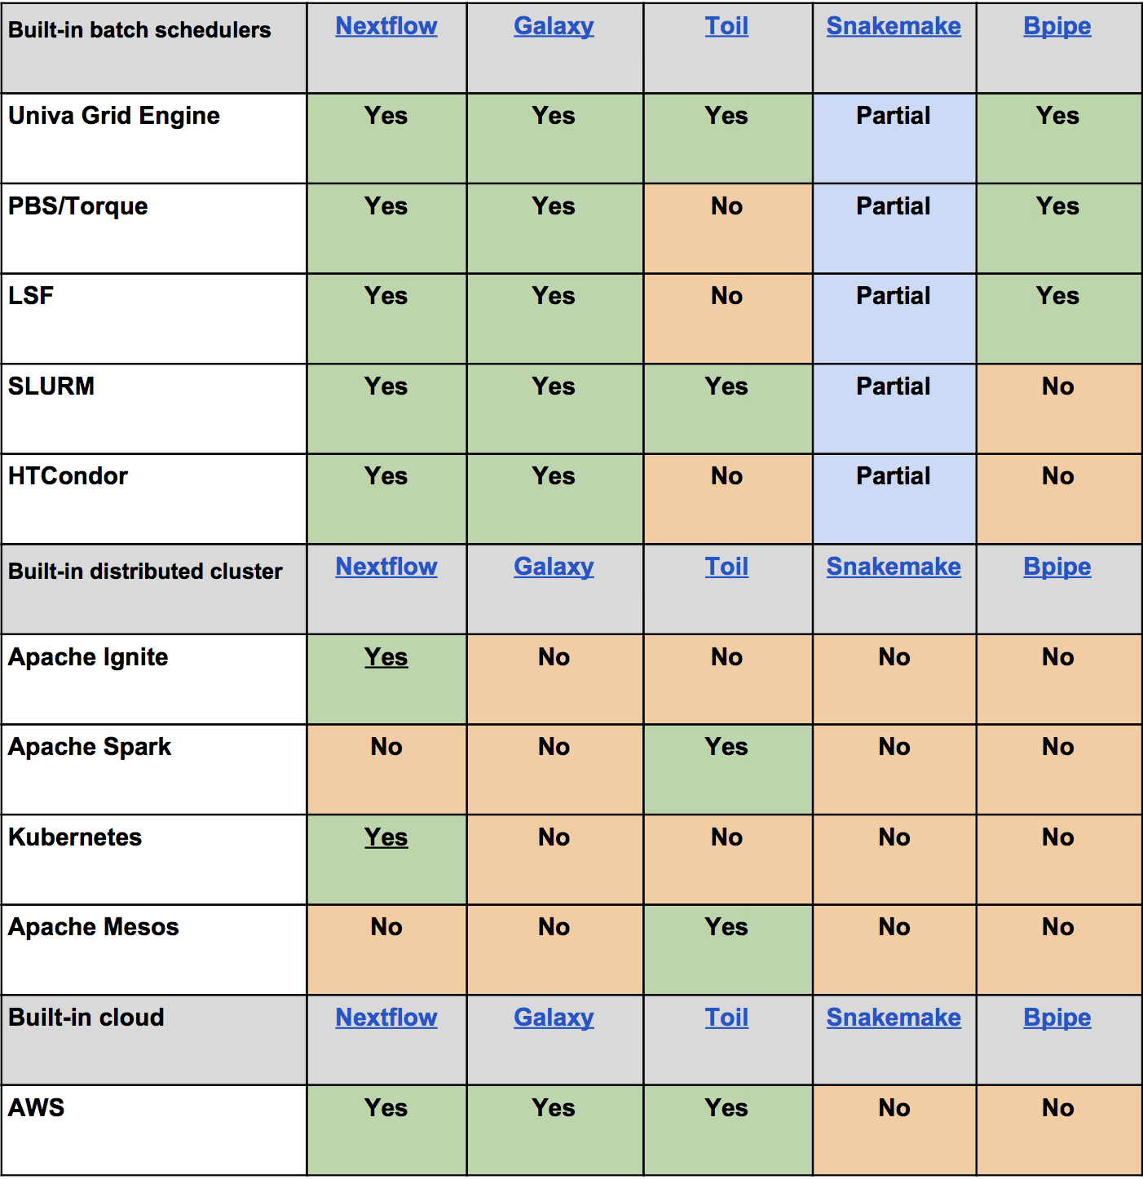

Slide 23
self-contained and reproducible analysis
reuse any existing scripts/tools
automatic data parallelization
portable across multiple platforms
→ allowing scientists to focus on the application logic, instead of the low-level implementation details
Notes:
The fast start-up time for Docker containers technology allows one to virtualise a single process or the execution of a bunch of applications, instead of a complete operating system. This opens up new possibilities, for example the possibility to "virtualise" distributed job executions in an HPC cluster of computers.
which guarantees the consistency of the results over time and across different computing platforms.

Slide 24
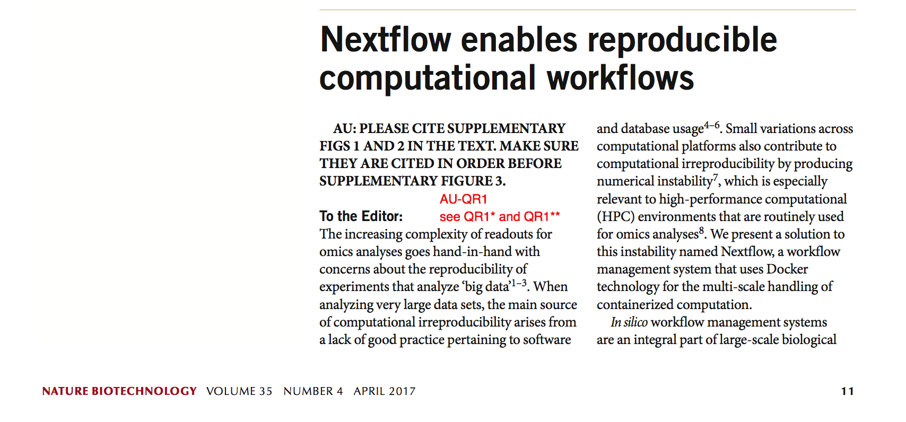
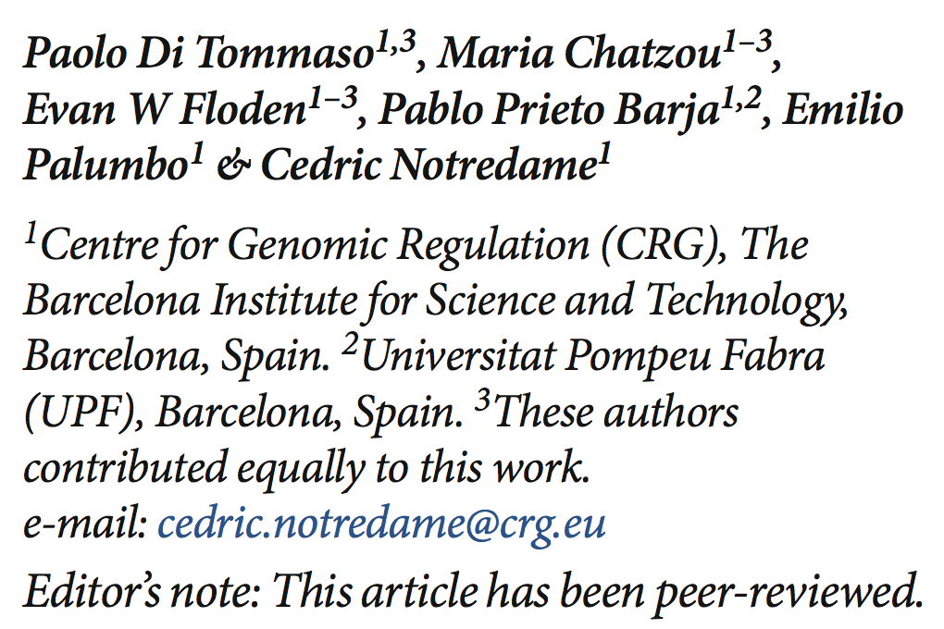

Slide 25
* Companion parasite genome annotation pipeline, Steinbiss et al., DOI: 10.1093/nar/gkw292

Slide 26
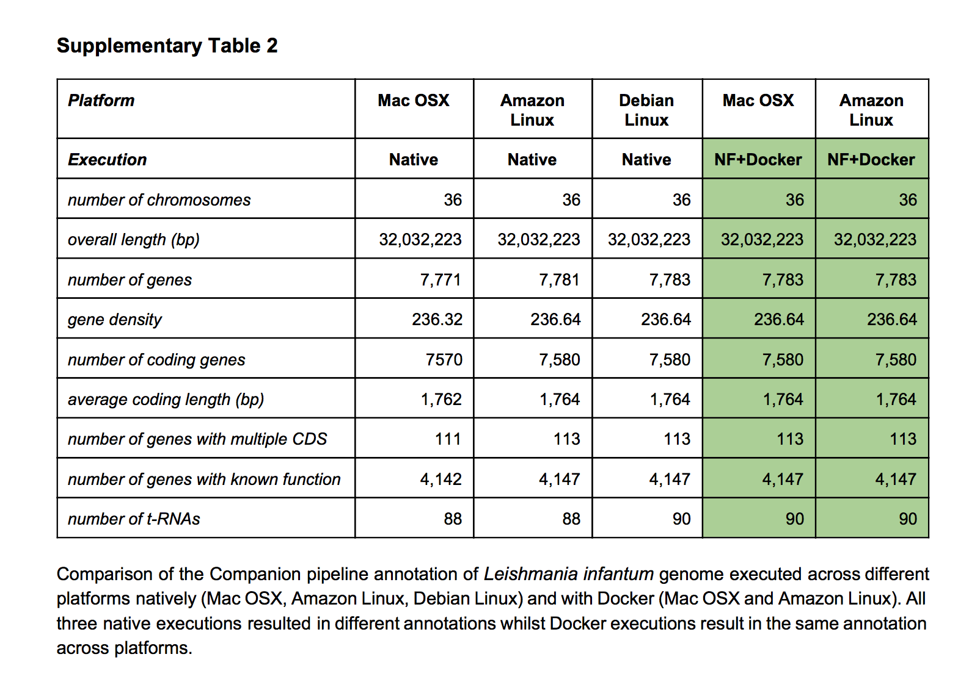
* Companion parasite genome annotation pipeline, Steinbiss et al., DOI: 10.1093/nar/gkw292
All Computations Stable on a Given Platform

Slide 27
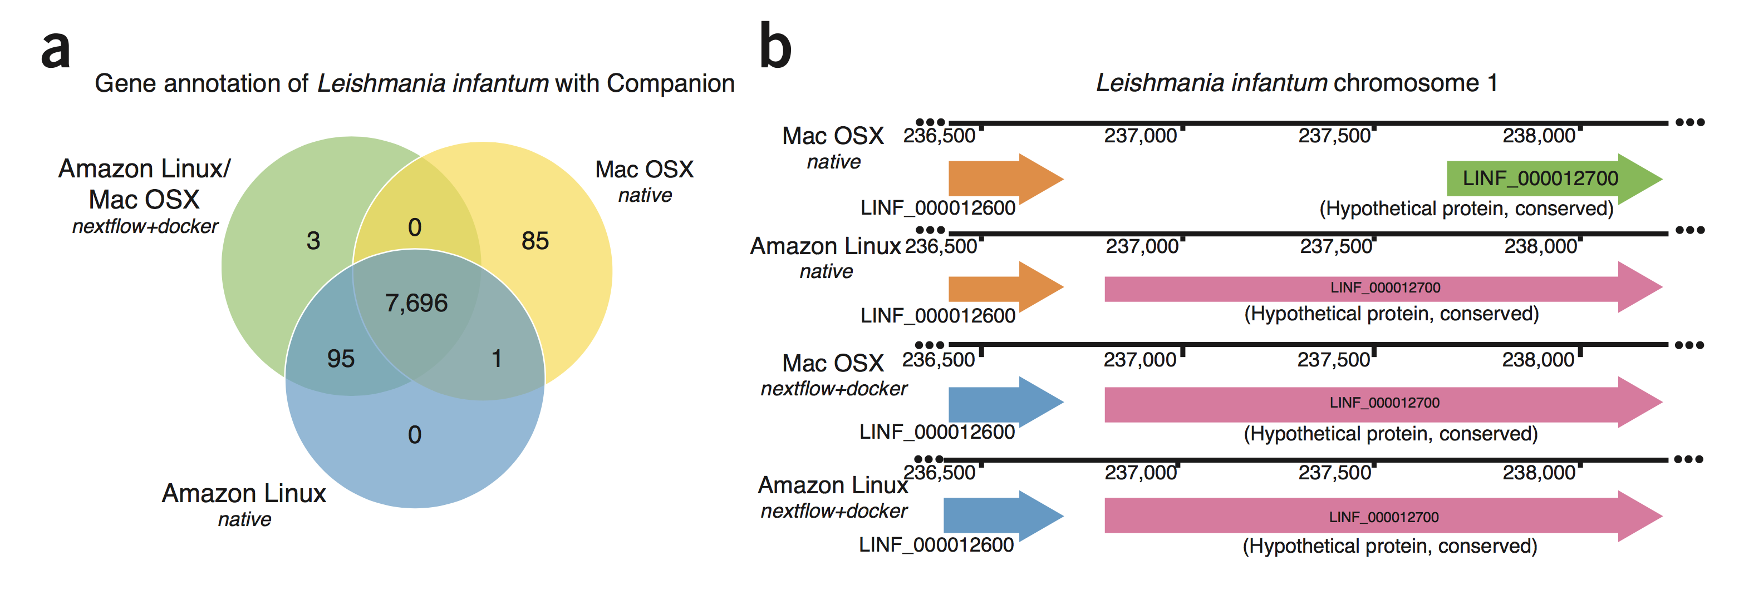

Slide 28
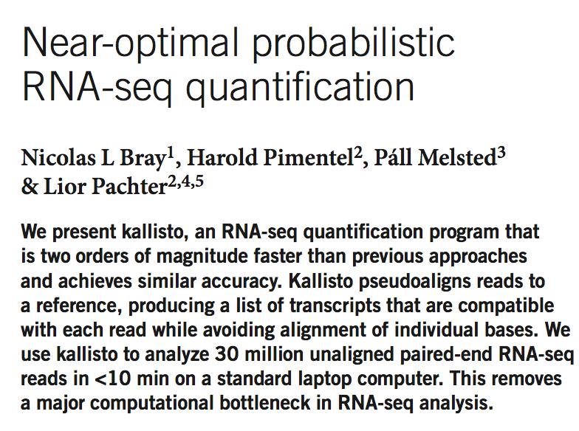
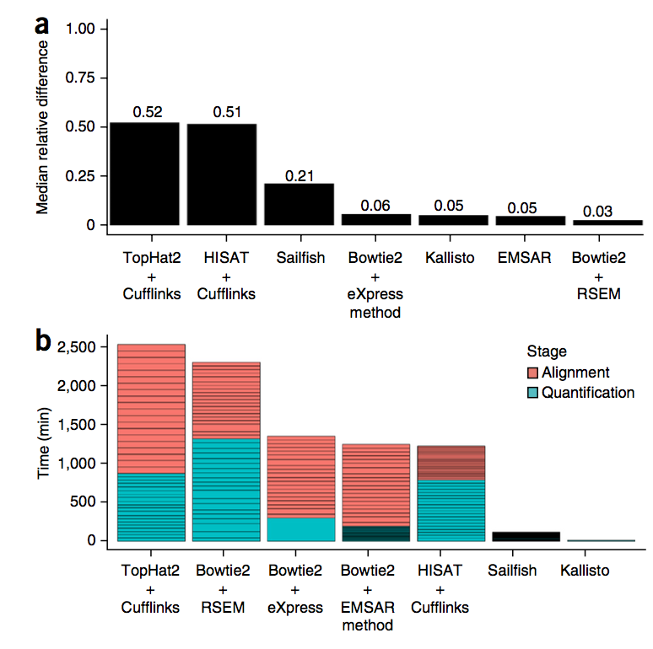
Is Kalisto Numerically Stable?

Slide 29
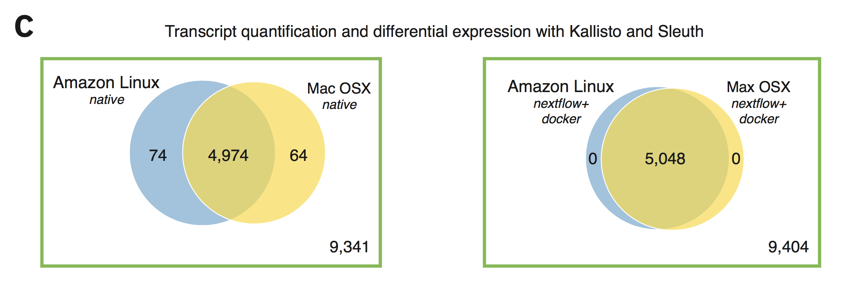

Slide 30
Giving Bad News is Only Fun if you have bad news
For Everybody

Slide 31
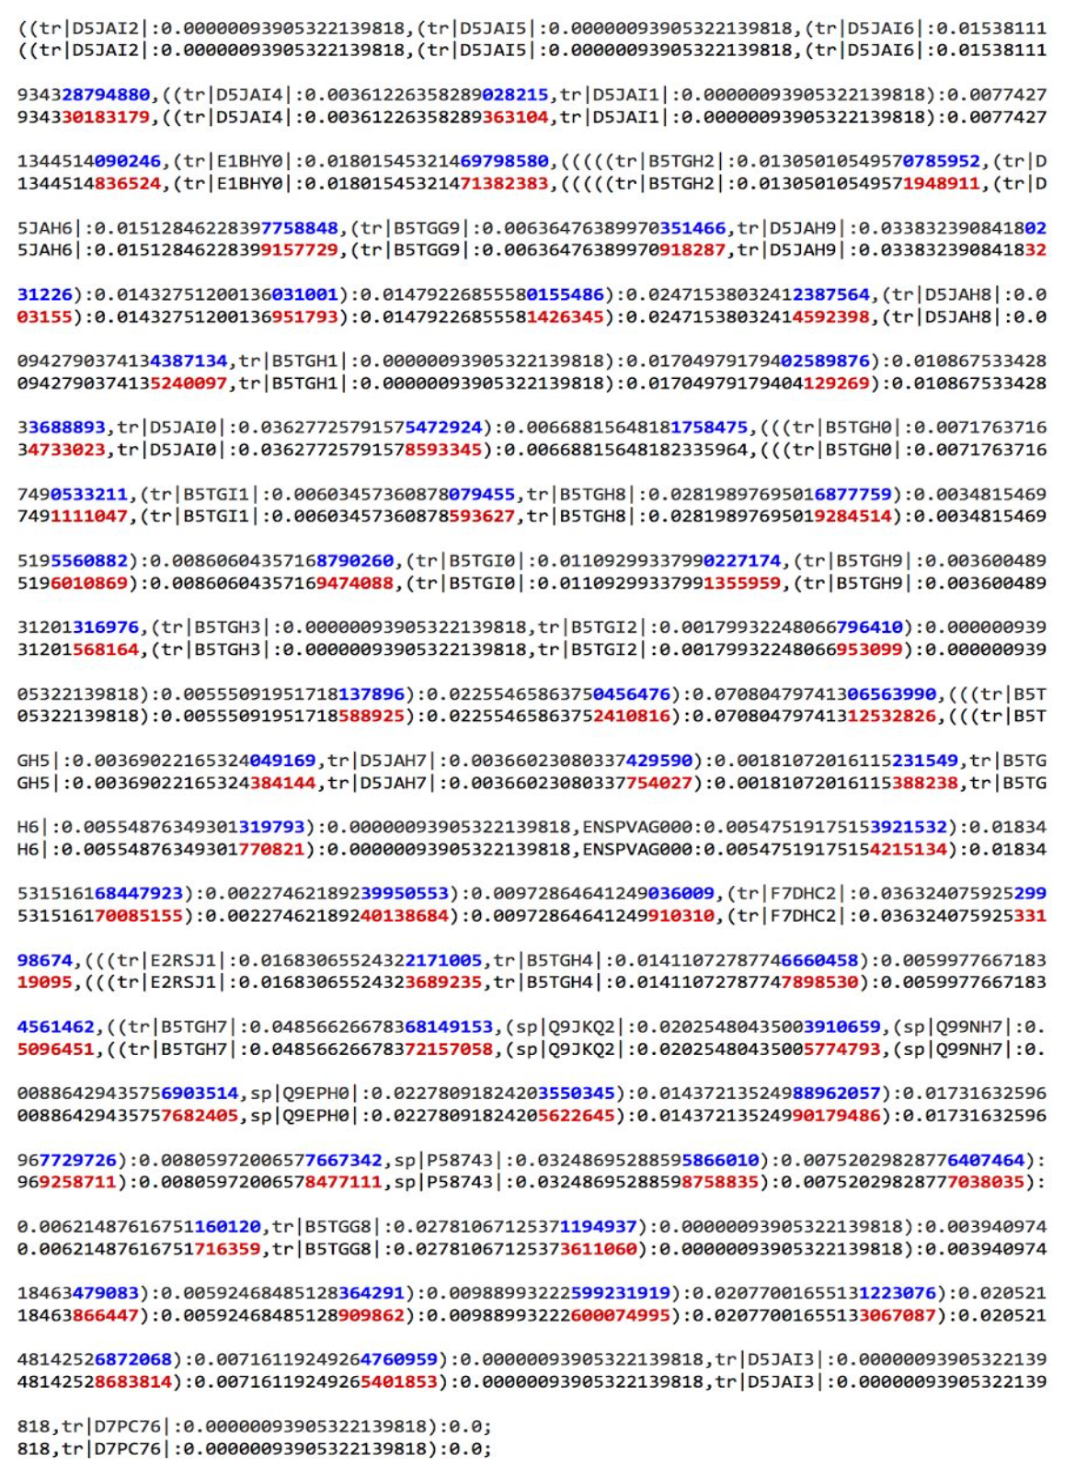
ML Trees are just
As Unstable?

Slide 32
Numerical Stability
Notes:
Nextflow has been one of the first framework, that fully supports Docker containers and allows pipeline execution in an isolated and easy to distribute manner.

Slide 33
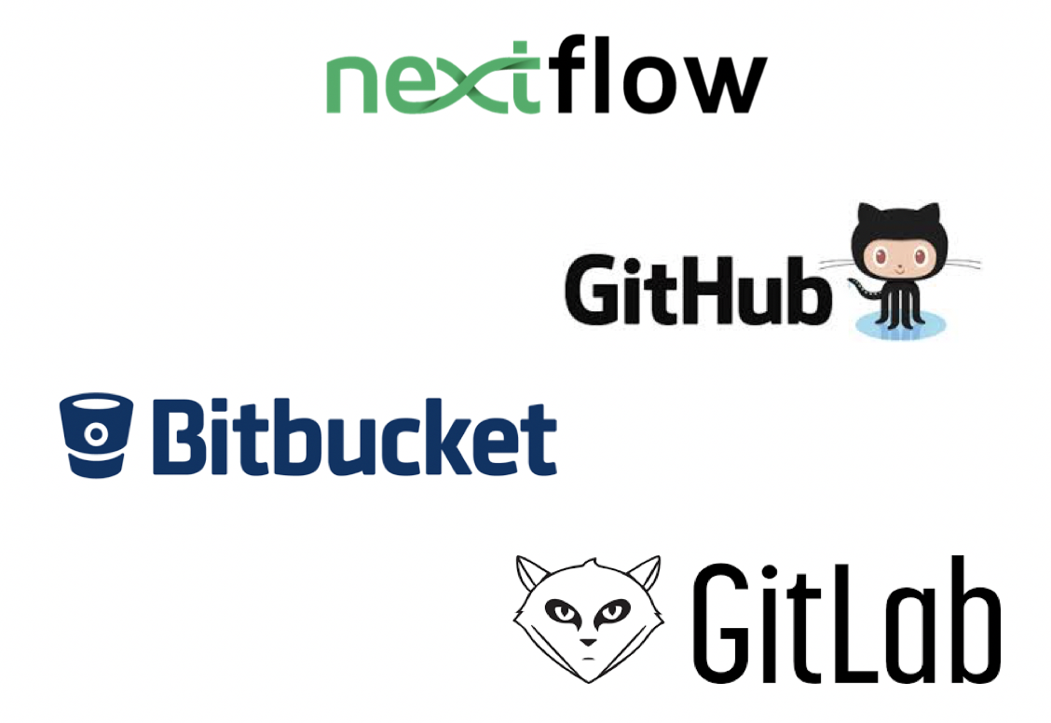


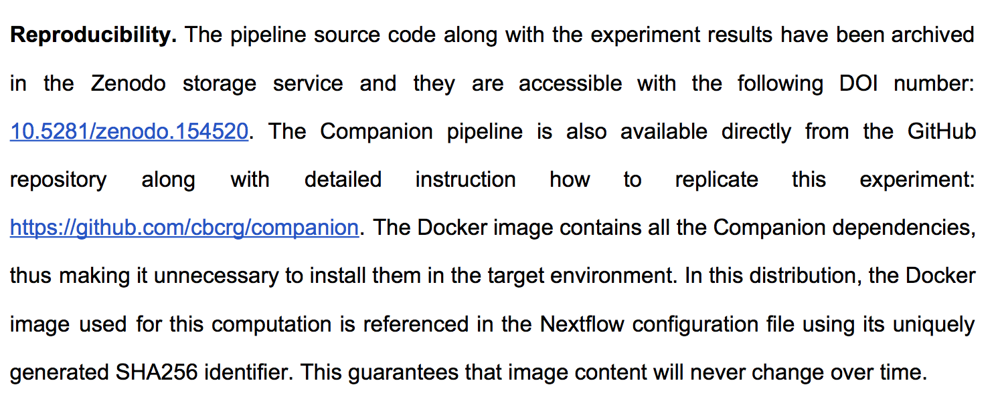

Slide 34























Who is using ?
Notes:
Nextflow is only 3 years old and in this 3 years it rapidly reached a point were nowadays is being used by over 50 big Institutions, Universities & Companies worldwide. We have a live community of about 300 bioinformaticians that we support on a daily basis. The purpose of saying this is not to highlight how great Nextflow is, because Nextflow is useless to you unless you are a bioinformatician or you have a company that does a lot of bioinformatics. So the purpose of this slide is to highlight how big the need for innovative software technologies is and how rapidly such a technology would get adopted.

Slide 35

Best Mapper |Benchmark
Best Quantifier | Benchmark
Best Tool X | Benchmark
Benchmark
Notes:
Need for rigorous tests of complete computing environments, not just pipelines, in order to guarantee reproducibility and assure quality.

Slide 36
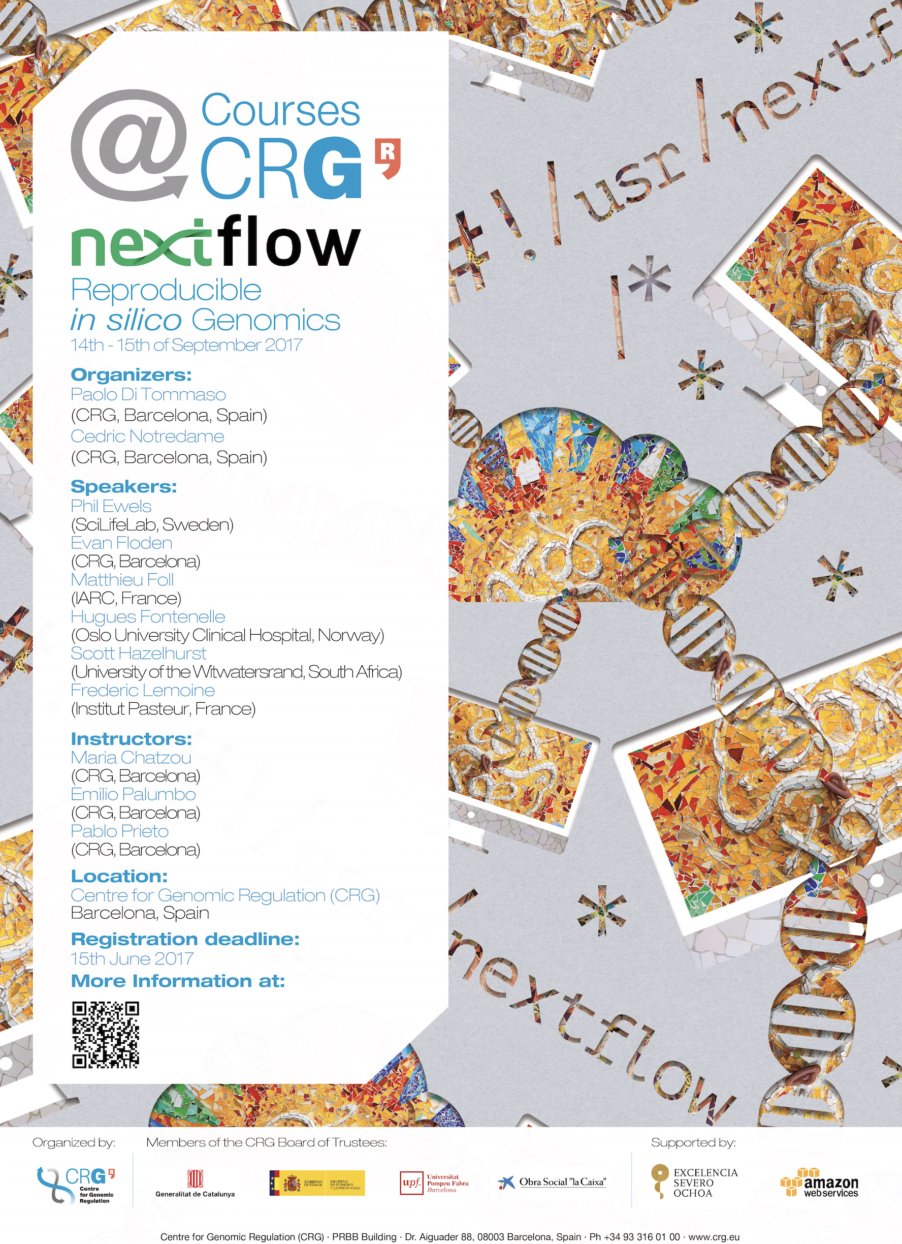
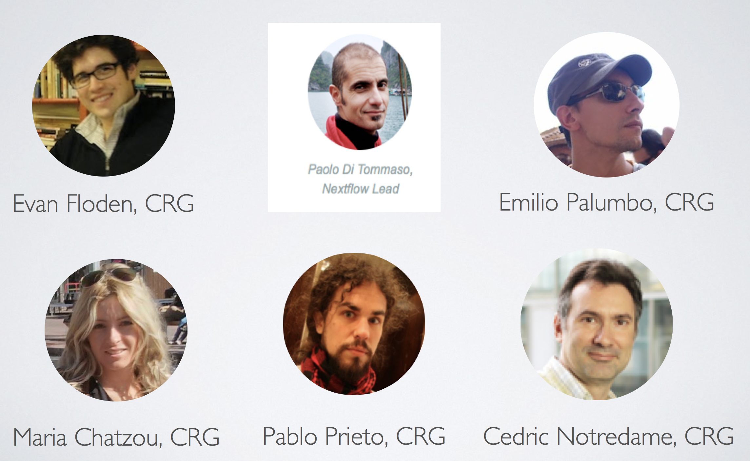
www.nextflow.io
Workshop:
14/15 September 2017

Slide 39
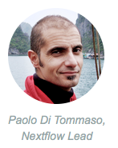
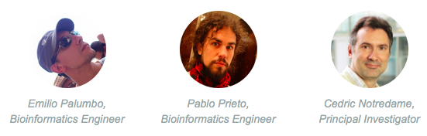
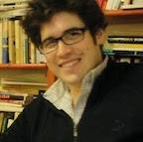
Thank you
^{http://nextflow.io}
Evan Floden, Bioinformatician

Slide 40
Naive approach
Host
Docker image
User application
Workflow scripts
Config files
Environment
Binary tools
Libraries
Docker engine
Operating System

Slide 41
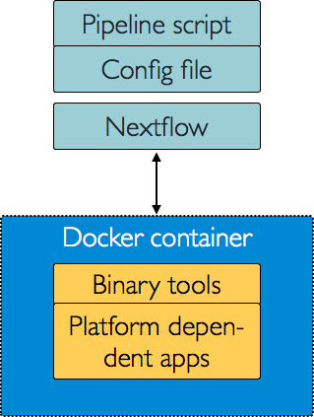
Our solution

Slide 42
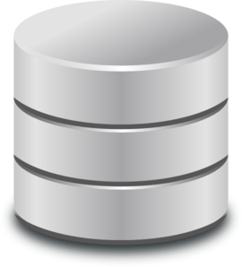
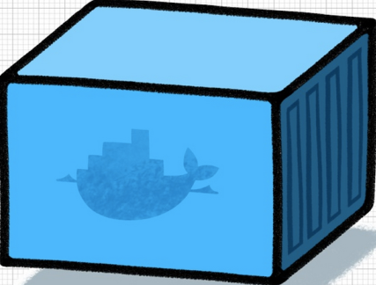
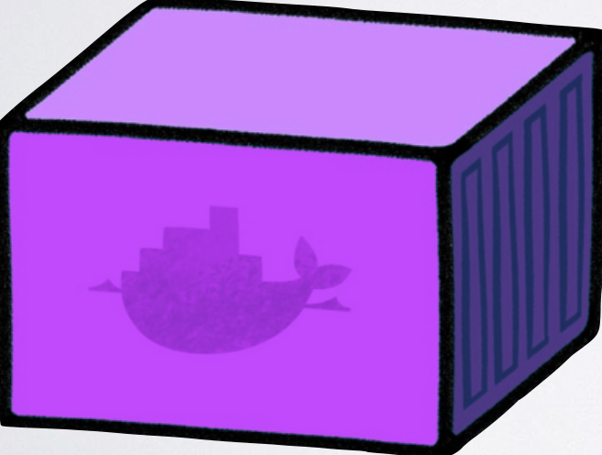


Our solution
Nextflow
Registry
Host file system

Slide 43
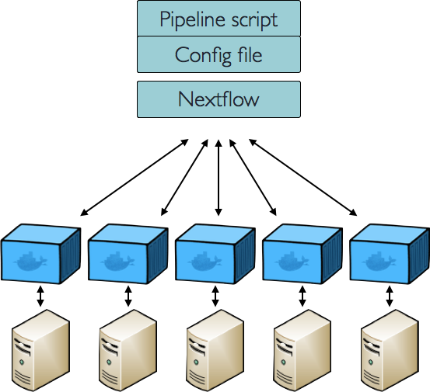
Our solution – on a Cluster

Slide 44
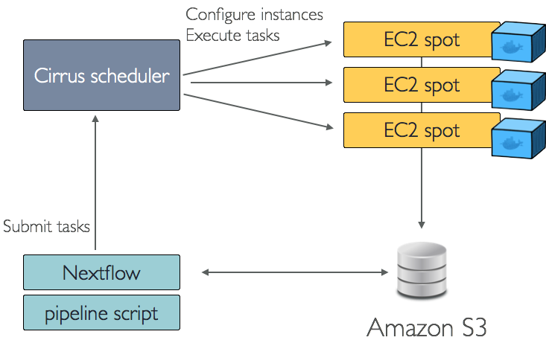
Our solution – on a Cloud

Slide 45
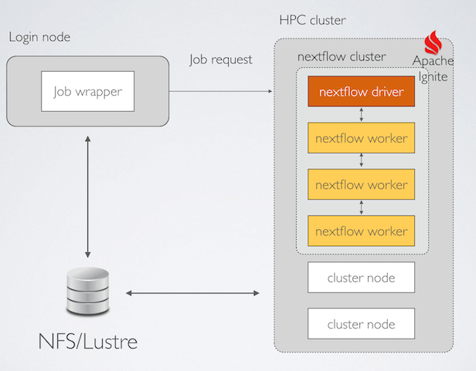
Our solution – on a Supercomputer

